Slide 1
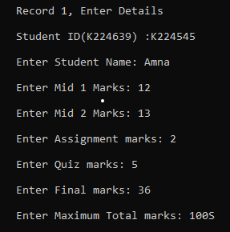
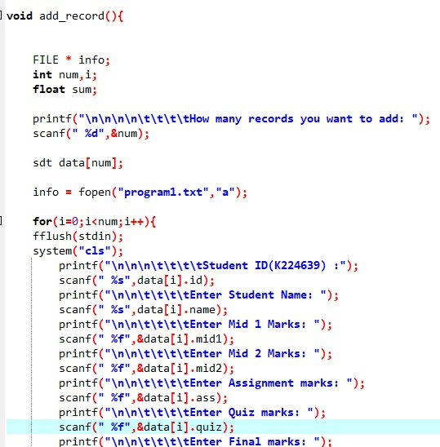
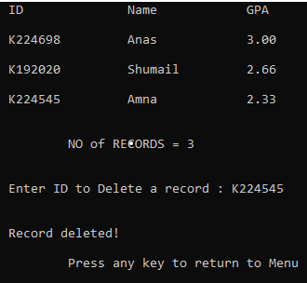
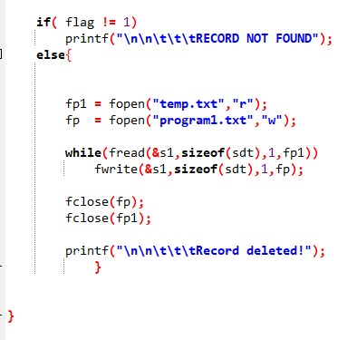

add_record function
Asks User for data.
Check whether ID exists in database.
Stores Data in the text file using file pointer.
delete_a_record function
Asks User for ID to delete record
Makes a temporary text file and stores each record in it, except the record user wants to delete.
After that data is copied in main text file

Slide 2
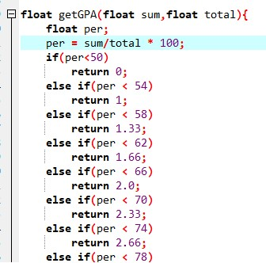
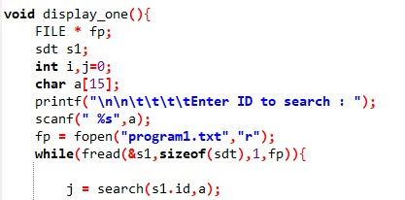
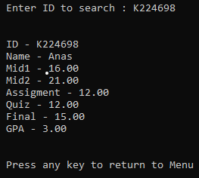
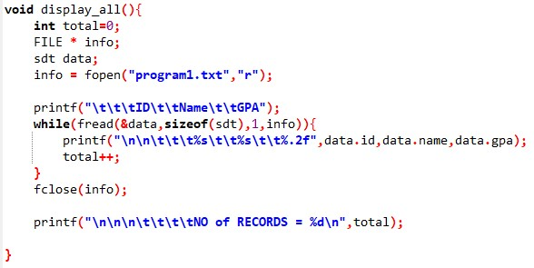
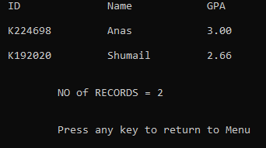
getGPA function
Display_one function
Display_all function

Slide 3
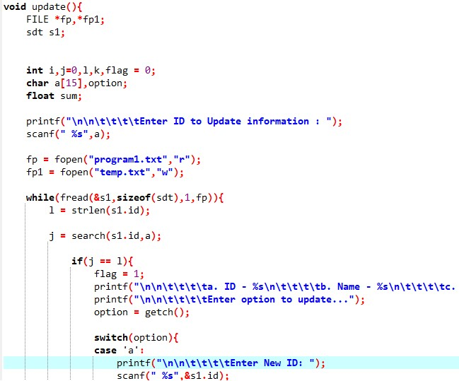
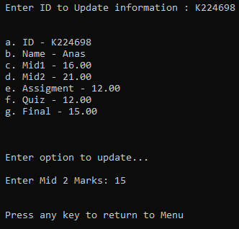
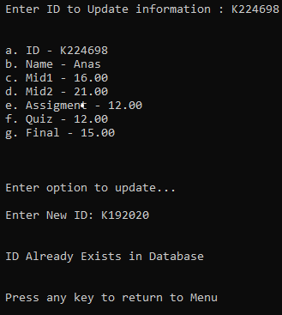
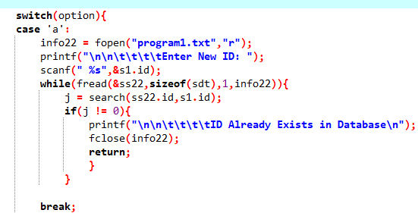
update function
Asks User for ID to Update record
Makes a temporary text file and stores each record in it.
When ID, which was given by user, is found , record is updated and then stored.
If ID is updated function checks whether updated ID already exists in database.
If marks are updated, it calculates gpa again, and then stores record.
After that data is copied in main text file

Slide 4
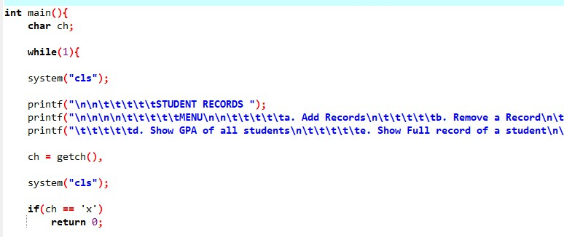
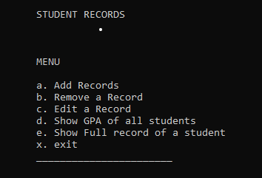
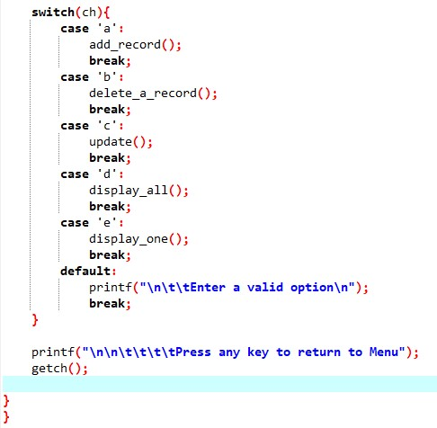
Main function
Asks User to enter choice from Menu.
Calls functions using switch case
Menu

